Slide 1
Geographic tools and resources
MEASURE Evaluation
Notes:
Fundamentals of Geographic Data

Slide 2
Lesson Objectives
Showcase geographic tools
Provide resources for geographic data

Slide 3
Review of Lesson 1 and 2
Everything happens somewhere
Geographic context can be used to link data
There are different ways that geographic data can be presented
It is important that a standard data schema be used to store geographic data in a database
Notes:
Before beginning, let’s review some key concepts from lessons one and two. In lesson one we learned that there is a geography to everything that humans do and it is possible to use that geographic context to better understand what is happening where. Geographic context can also be useful for linking data. Linked data can show relationships that might not be apparent otherwise, such as the OVC and poverty example.
In lesson 2 we discussed the ways that geographic data can be collected and represented. Additionally, we discussed the importance of storing geographic data in a database and using a standard data schema.

Slide 4
Tools for Geographic Data and Analysis
Software
  ArcGIS
  QGIS
  E2G
Resources
  Data
  Training
Notes:
In this lesson we’ll discuss tools for geographic analysis. Unfortunately we won’t be able to provide you with training in the specific software, however we’ll present some resources that can help provide training.

Slide 5
GIS
Geographic
Information
System
Notes:
Let’s first talk about the software that’s available to support geographic analysis, GIS. As mentioned previously, GIS stands for geographic information system

Slide 6
GIS
Manages spatial data
Supports geographic display (maps)
Facilitates spatial analysis
Notes:
The main feature of GIS is it’s ability to manage spatial data. It is in essence a specialized database program that links data to geography. This capability makes it possible to support geographic display of that data, usually by making a map. Lastly, most GIS programs make it possible to do some spatial analysis of that data. Such as calculating distances, creating buffers and so on.

Slide 7
GIS
Important to find the software best suited to:
  Analysis needs
  Skillset of users
  Cost
Notes:
There are many different GIS programs available. It’s important therefore to find the software best suited to your analysis needs (how you will use the data), the skillset of the people using the software (some GIS programs have a steeper learning curve than others) and lastly the cost (some GIS programs cost more than $1,000 US dollars while others are free.
Now I’d like to review some different GIS software options.

Slide 8
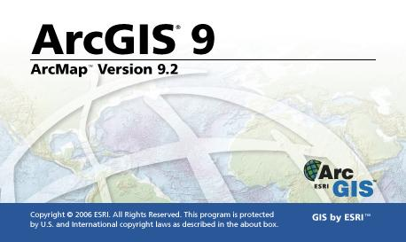
ArcGIS
www.esri.com
Notes:
First there’s ArcGIS. ArcGIS is a very powerful software package.
It provides many tools, many of which are specialized for types of analysis that are more common in other sectors such as business analysis, natural resources, etc.
But it is the market leader for GIS and many people use it in the health sector, especially in national government ministries.

Slide 9
ArcGIS
Pros
Industry leader
Deeply involved in public health applications
Extensive technical support resources
Powerful, extensive inventory of tools and data
All-in-one, one-stop software package
Notes:
ESRI also provides some great technical support resources. Its online support service provides a great search tool for finding solutions to most of the problems you’ll encounter. You can even download programming code or extensions other users have created to solve the problem you might be having.
The ArcGIS product comes with an inventory of geographic data, from country boundaries to city locations and roads. These are supplied in the ESRI Data and Maps product. ArcGIS users can also access ArcGIS Online Services, which we talked about earlier, for no extra charge.
ArcGIS provides software modules to address just about any analytical or mapping need you might have, so ArcGIS can be an all-in-one, one-stop solution.
9

Slide 10
ArcGIS
Pros
Industry leader
Deeply involved in public health applications
Extensive technical support resources
Powerful, extensive inventory of tools and data
All-in-one, one-stop software package
Cons
Expensive
Many products that require separate licenses
Time-consuming to learn
System requirements
All-in-one, one-stop software package
Notes:
What are the cons?
First, ArcGIS can be expensive, especially if you need to buy add-ons that require separate licenses.
Next, because of how feature-rich the software is, it can be complex and time-consuming to learn.
Then you have the system requirements, which are pretty substantial. See next slide.
10

Slide 11
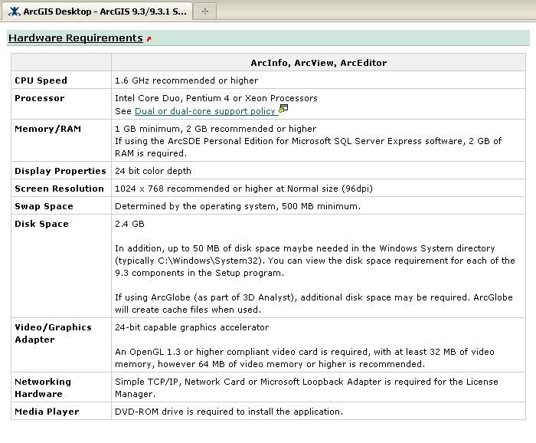
ArcGIS
Source: www.esri.com
Notes:
Take a look at the system requirements for ArcGIS. It requires a
Pentium 4 processor;
1 to 2 GB of RAM, depending on your installation;
2.4 GB disk space;
500 MB minimum swap space; and a
DVD-ROM drive for installation.
These are pretty stout requirements.

Slide 12
ArcGIS
Pros
Industry leader
Highly involved in public health applications
Extensive technical support resources
Powerful, extensive inventory of tools and data
All-in-one, one-stop software package
Cons
Expensive
Many products that require separate licenses
Time-consuming to learn
System requirements
All-in-one, one-stop software package
Notes:
All in all, the ArcGIS product offers so much functionality that its greatest strength can also be its greatest weakness, depending on your technical resources and time available to learn the software.
12

Slide 13
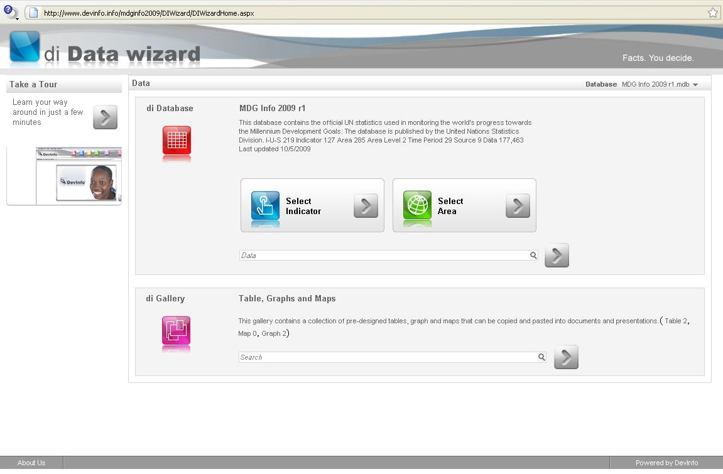
DevInfo
www.devinfo.org
Notes:
DevInfo, as probably everyone knows, is the U.N. tool created to facilitate reporting on progress toward achievement of the Millenium Development Goals, or MDGs. DevInfo isn’t really a GIS, since it offers limited GIS analytical tools, but it provides some good cartographic tools and is worthy of mention.
If you look at the interface, you can see that it uses a very controlled, step-by-step process. First you select an indicator, then you select a geographic area, then you select the type of output you want, whether it be a table, map, or graph.

Slide 14
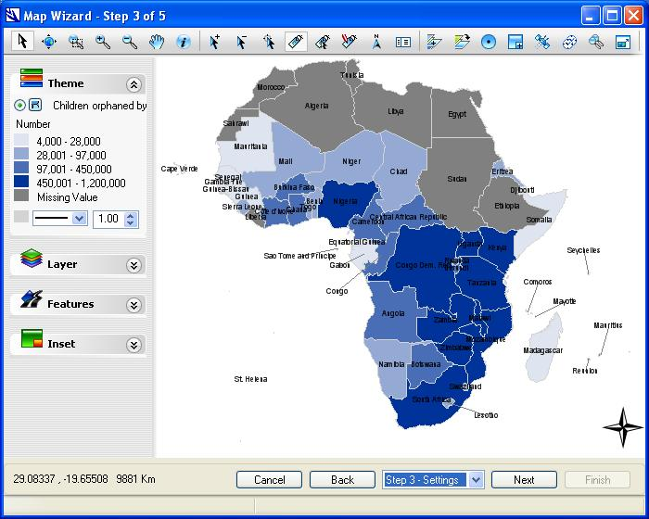
DevInfo
Notes:
Here’s a map created using DevInfo.
The interface is nice, albeit tightly controlled and step-by-step, and gives you a fair amount of control over the cartographic design.

Slide 15
DevInfo
Pros
Free
Appealing interface
Solid data management and mapping tools
Excellent reporting tool
Easy, step-by-step flow
Supports any geographic level of data
Product well-supported by UN
Notes:
The pros: (read slide)
15

Slide 16
DevInfo
Pros
Free
Appealing interface
Solid data management and mapping tools
Excellent reporting tool
Easy, step-by-step flow
Supports any geographic level of data
Product well-supported by UN
Cons
Limited GIS capabilities
Focused exclusively on reporting for MDGs
Step-by-step process can be restrictive
Learning curve for customization
Notes:
The pros: (read slide)
“Learning curve for customization” – means that we’ve found it challenging to import your own data into Dev-Info.
16

Slide 17
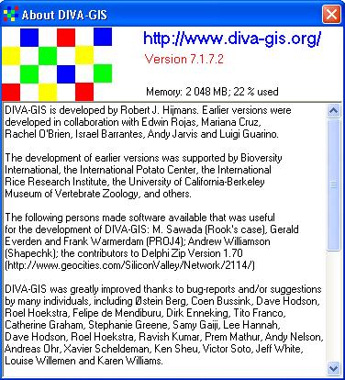
DIVA-GIS
www.diva-gis.org
Notes:
DIVA-GIS is a free software package that was created primarily for analyzing and mapping biodiversity data, such as the distribution of species or other point-based patterns.
It also reads and write several standard data formats, such as ESRI shapefiles, and contains some basic cartographic tools to allow you to create maps.

Slide 18
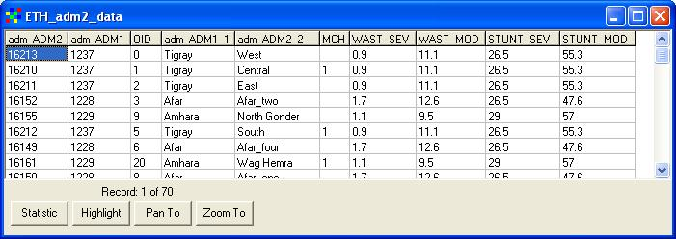
DIVA-GIS
Notes:
DIVA-GIS provides the ability to view and query data in tables, and to display the results as a map.

Slide 19
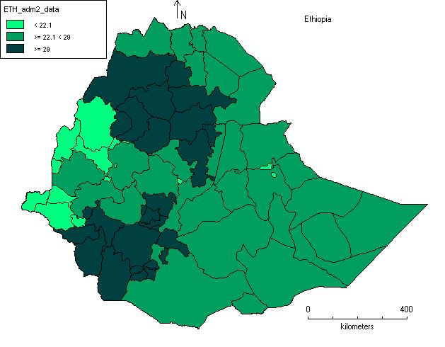
DIVA-GIS
Notes:
Here’s a sample map created using DIVA-GIS. You can see that you can create thematic/choropleth maps, and that you have some cartographic controls, such as a legend, north arrow, scale bar, and title.

Slide 20
DIVA-GIS
Pros
Free
Uses shapefiles and standard image formats
Provides some basic statistical and mapping tools
Notes:
The positives for DIVA-GIS are that
It’s free.
It can also import and export shapefiles and several standard image formats.
And it provides some basic mapping tools that are fairly easy to use once you figure out where they are.
DIVA-GIS would be a good option for an organization that didn’t want to invest a lot of time and money in acquiring a software package, and just needed some fundamental tools.
20

Slide 21
DIVA-GIS
Pros
Free
Uses shapefiles and standard image formats
Provides some basic statistical and mapping tools
Cons
Learning curve; interface not intuitive
Not designed for public health professionals
Analytical tools biased toward raster data
Notes:
The cons:
There’s a bit of a learning curve with all the different functionality, and all the menus and buttons to investigate before you find what you need.
Part of the problem is the focus of the software package, which is the study of biodiversity and not public health.
As a result, many of the analytical tools are oriented toward processing of raster images.
21

Slide 22
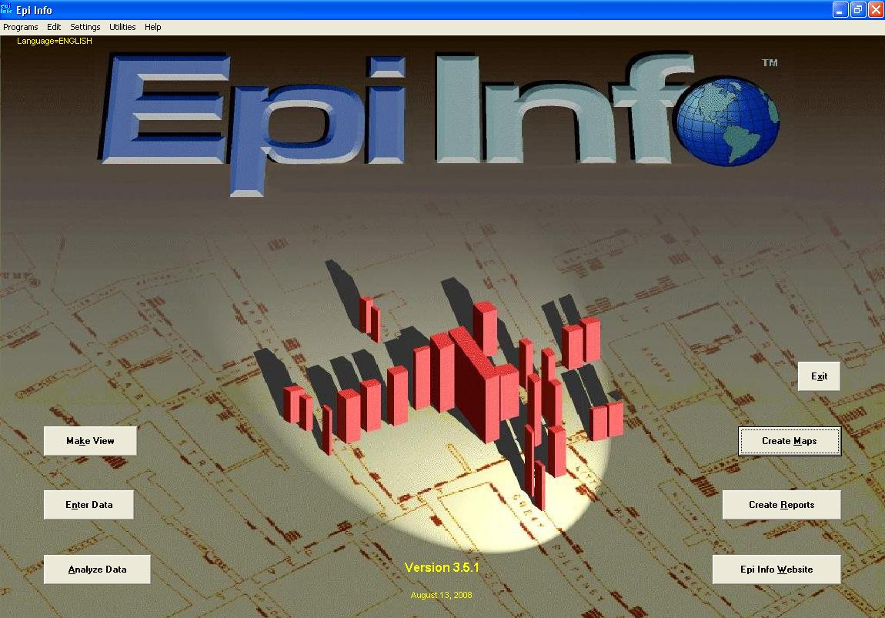
Epi Info / Epi Map
www.cdc.gov/EpiInfo
Notes:
Epi Map is the mapping component of Epi Info, the software package created by the CDC in Atlanta.

Slide 23
Epi Info / Epi Map
Design questionnaires or forms
Enter data
Analyze data
Create maps
Create reports
Notes:
Epi Info is perhaps best suited for data from surveys. It provides an integrated combination of data entry, analysis, mapping, and reporting functionality all in one place.
23

Slide 24
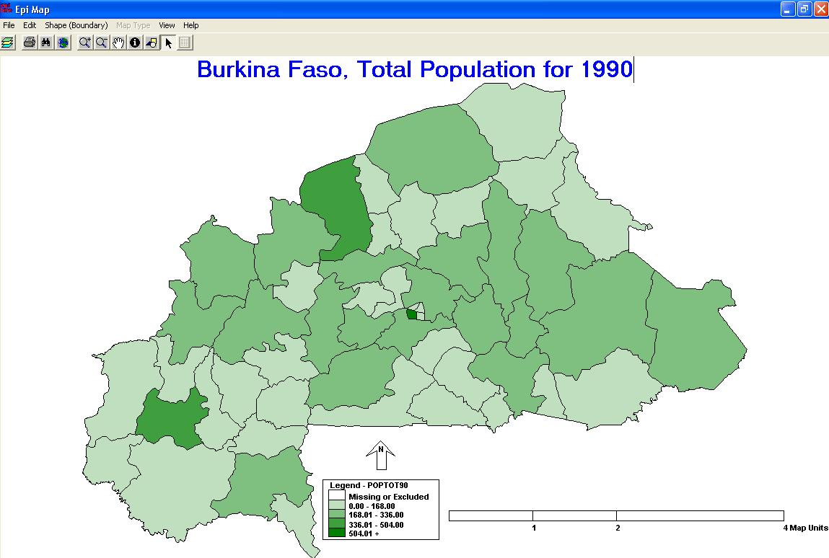
Epi Info / Epi Map
Notes:
Here’s an example of a map created in Epi Map. The data side of the software package is very strong, as it includes lots of statistical analysis tools and the ability to edit geographic features in shapefiles, but the cartographic display is very basic.
For example, the title must appear in the center of the top of the page, and the legend, north arrow, and scale bar are grouped together as a single graphic for display.
24

Slide 25
Epi Info / Epi Map
Pros
Free
Designed for public health professionals
Combination of data entry, statistics, mapping, and reporting
Data management and statistical tools
Can edit shapefiles directly
Notes:
What are the pros of using Epi Info and Epi Map? (Just read the slide).
25

Slide 26
Epi Info / Epi Map
Pros
Free
Designed for public health professionals
Combination of data entry, statistics, mapping, and reporting
Data management and statistical tools
Can edit shapefiles directly
Cons
Limited GIS functionality
Limited cartographic tools
Infrequent updates
Notes:
And the cons?
Epi Map is not a true GIS. It can perform some basic GIS functions, and can do some basic data manipulation things, such as editing a shapefile directly or opening only part of a shapefile, but is really focused on creating maps.
In terms of the maps that can be created, as we saw a few slides ago in the sample map of Total Population for Burkina Faso, the cartographic tools are not that advanced. You can produce some basic maps, but if you wanted to be more creative with a map composition, you’d need to use a more complete package.
Lastly, it is not clear what the update schedule for the software may be. So it may not be a good long-term solution
26

Slide 27
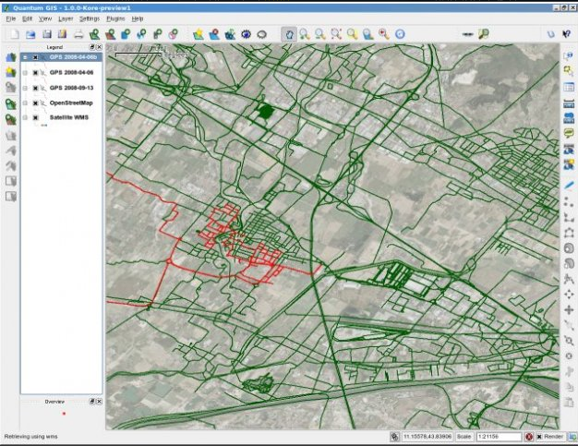
QGIS
Notes:
Lastly, I’ll mention QGIS. It is a free, open source mapping program. At MEASURE Evaluation, we’ve started using QGIS more frequently because it is easy to learn, has solid functionality, it’s free and there are resources available to help users learn how to use it.

Slide 28
QGIS
Pros
Free
Easy to use
Training materials available
Feature rich
Notes:
The advantages with QGIS are that it is free and easy to use. Additionally there are training materials available online that help users learn how to use the software. Lastly, for a free program it has a lot of nice features. It doesn’t do everything ArcGIS does, but for most people using it for public health and M&E it has enough features.

Slide 29
QGIS
Pros
Cons
Free
Easy to use
Training materials available
Feature rich
Missing some advanced capabilities
Notes:
As for cons, the most important one to mention would be that it is missing some advanced capabilities. However unless you are wanting to do very advanced GIS work, you may not miss them. If you’re doing advanced GIS work, you’ll probably want to invest in ArcGIS anyway.

Slide 30
Other mapping options
Google Earth
E2G
Geographic display only, limited data management
Notes:
The last two software packages I’ll mention aren’t technically GIS programs. They are geographic display tools. This means that unlike a true GIS, they don’t really provide many features in terms of managing data, they just simply display data geographically.

Slide 31
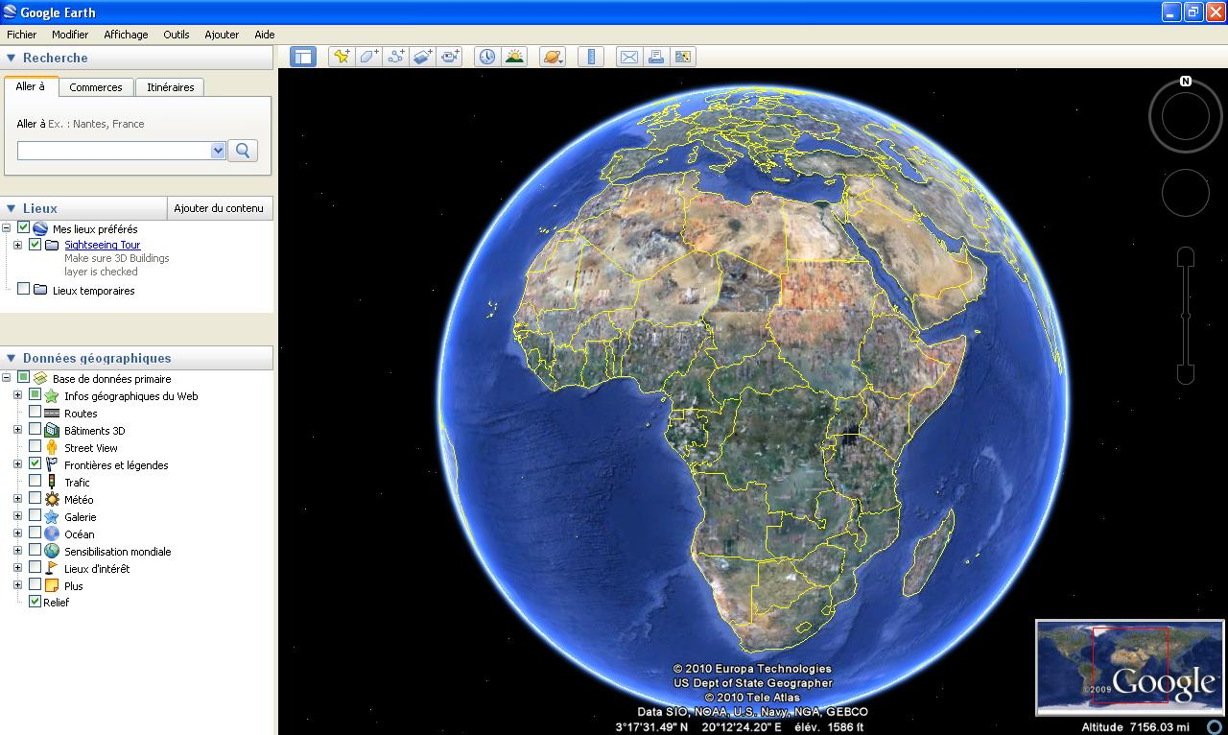
Google Earth
Notes:
First I’ll discuss Google Earth. How many people here today have used Google Earth? How many have used it a lot? Just a few times or not at all?
Well, for those of you who are unfamiliar with the tool, it provides a feature-rich base map for visualizing geographic data. And one can zoom in to view much of those data at a very large scale.

Slide 32
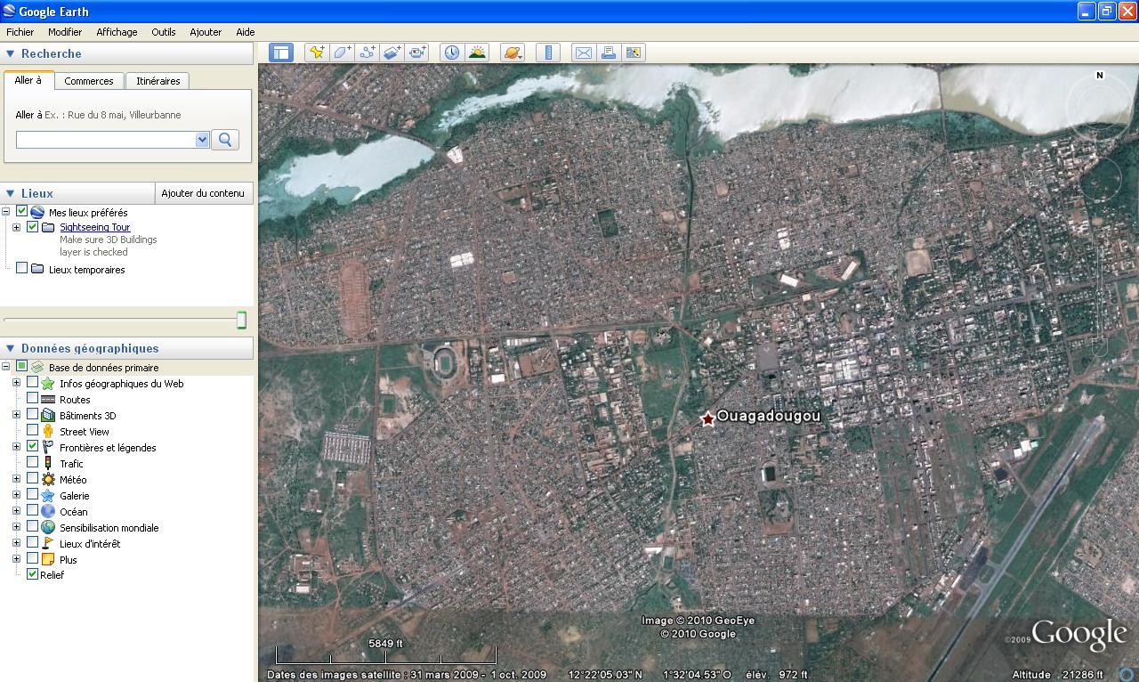
Google Earth
Notes:
Such as the area around Ouagadougou in Burkina Faso. For many rural areas, Google Earth provides imagery at a lower resolution, but for urban areas provides very high resolution imagery. In Ouagadougou, for example, one could zoom in to a smaller area, such as…
32

Slide 33
Google Earth
Notes:
the area highlighted here using a red circle, and see…
33

Slide 34
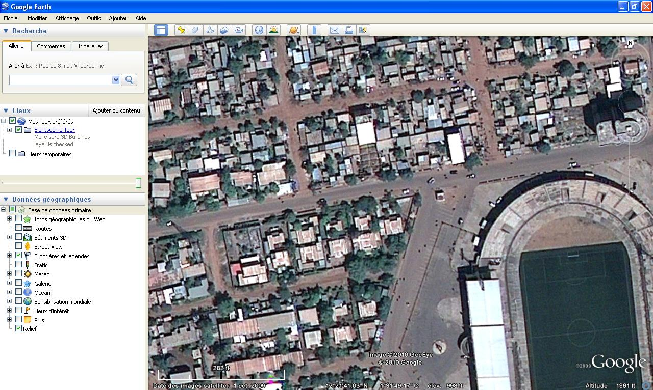
Google Earth
Notes:
an amazing amount of detail. The imagery is of such a high resolution that someone could use it to count the number of structures in this neighborhood.
34

Slide 35
Google Earth
Notes:
And if we look in the lower left corner of the display, we’ll see the date of the imagery. In this case it’s very recent, with a capture date of 1 Oct 2009, which is only four and half months old.
35

Slide 36
Google Earth
Notes:
On the left we have the many layers of data provided by Google Earth to serve as base maps and other items such as photos and other information people around the world have uploaded to Google Earth.
And then there are routes, boundaries, traffic, etc.
The coverage of these Google Earth features varies depending on where you are in the world, but for urban areas in Africa the selection of high-resolution imagery and detailed roads information appears to be quite good.
36

Slide 37
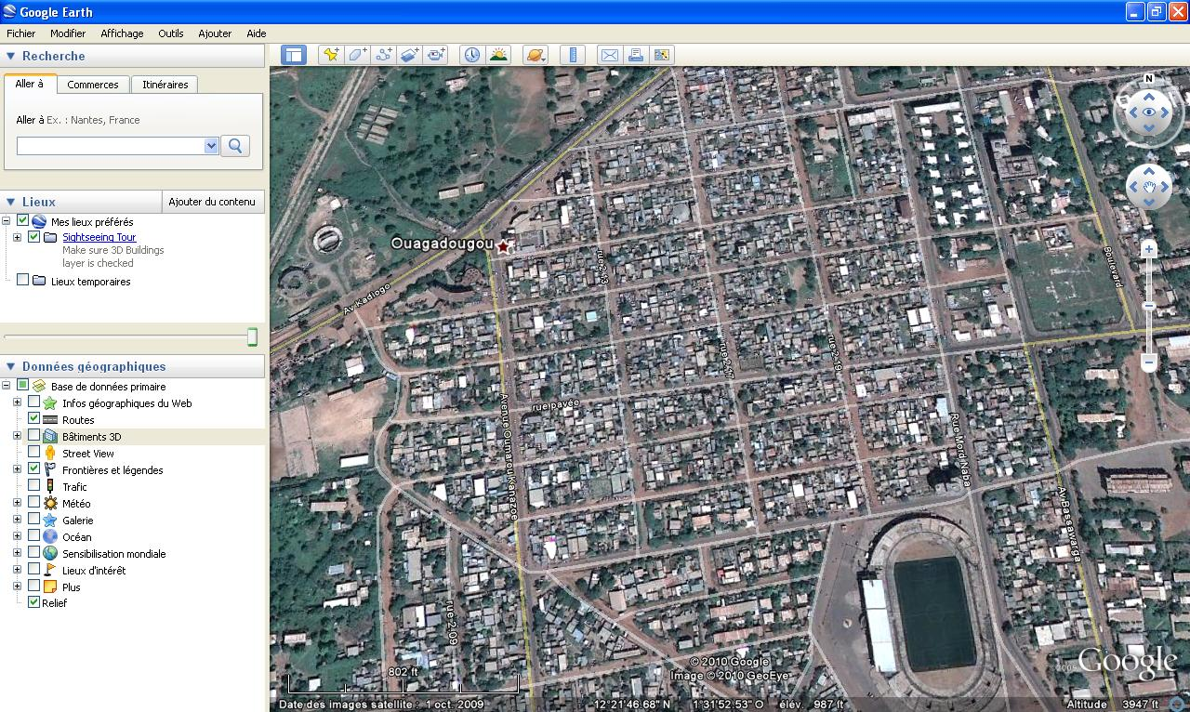
Google Earth: Ouagadougou
Notes:
For example, here is a section of Ouagadougou showing the detailed roads data that are available.
37

Slide 38
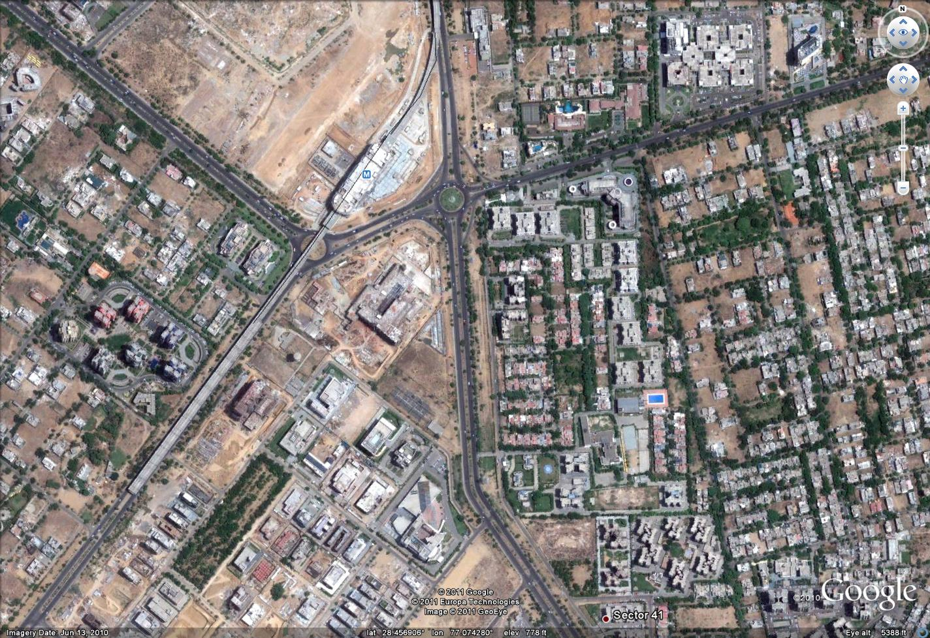
Google Earth: Delhi
Notes:
And here’s a section of Delhi.
38

Slide 39
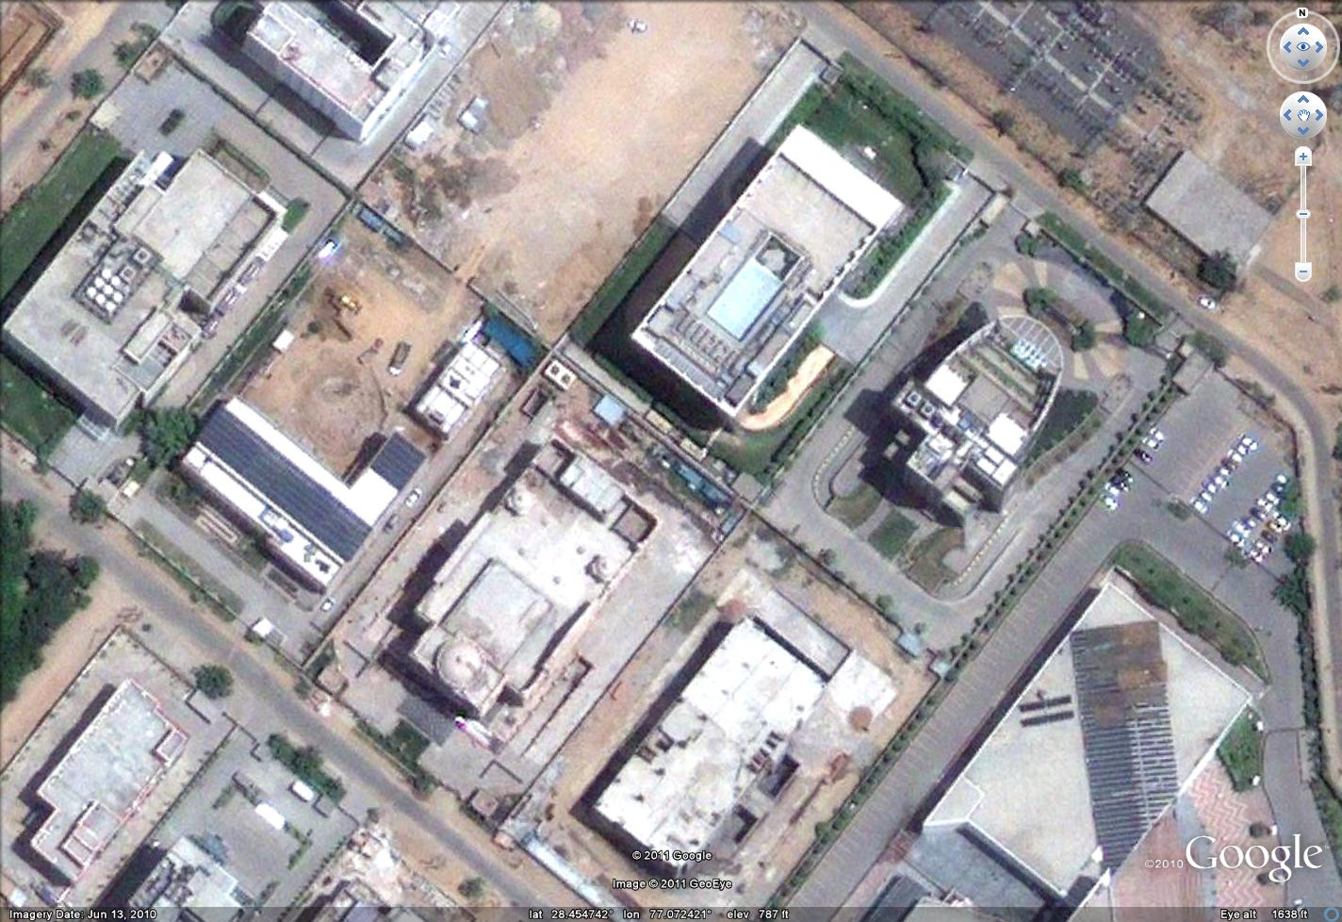
Google Earth: Delhi
Notes:
You can see how detailed it can be. This is the area around the Indian Institute of Public Health
39

Slide 40
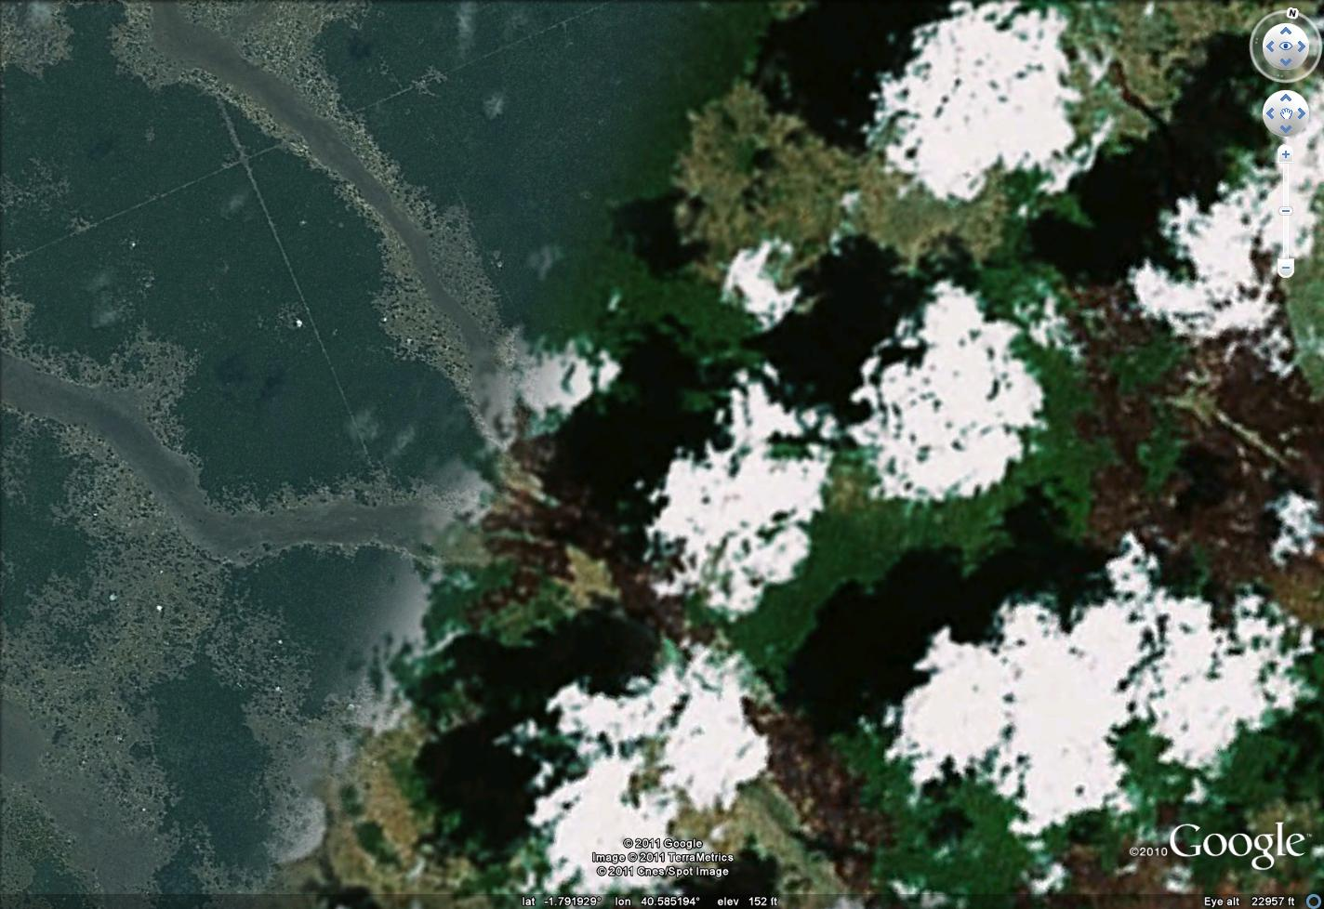
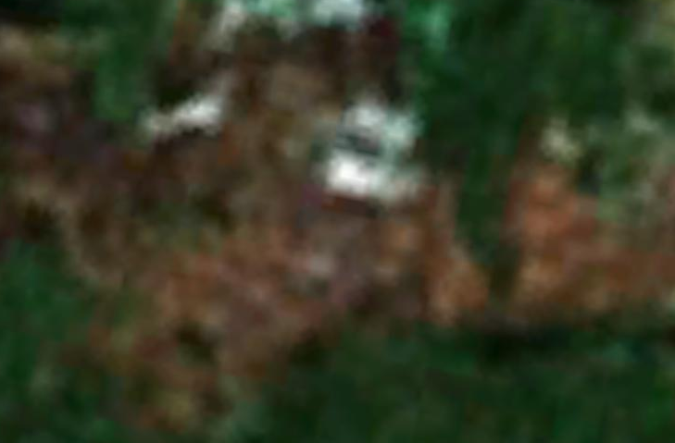
Google Earth: Low resolution
High
Resolution
Low
Resolution
Notes:
As I mentioned, not every area is available in high resolution. Here is an area where it switches from high resolution to low resolution. It is a little hard to see on this image, but on the low resolution side, if you zoomed in {CLICK TO HAVE BLURRY INSET ZOOM IN} it would be very blurry.

Slide 41
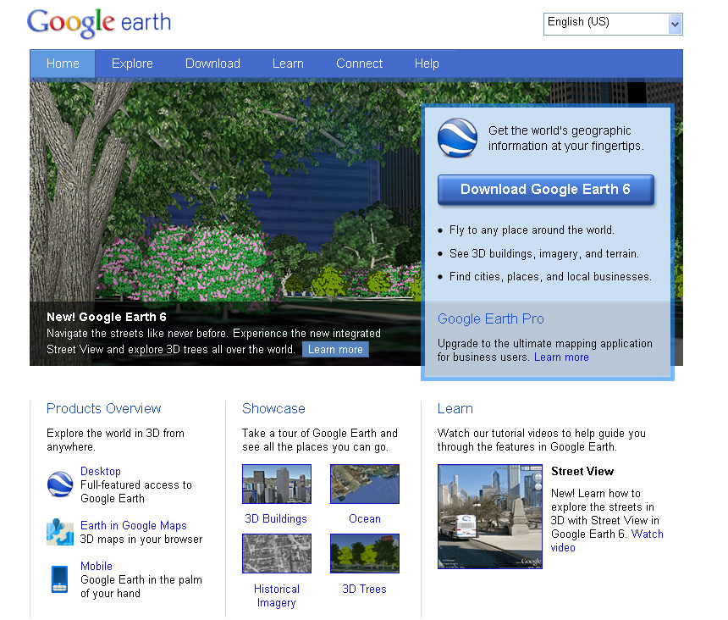
Google Earth
Notes:
Google Earth is available for free from Google
41

Slide 42
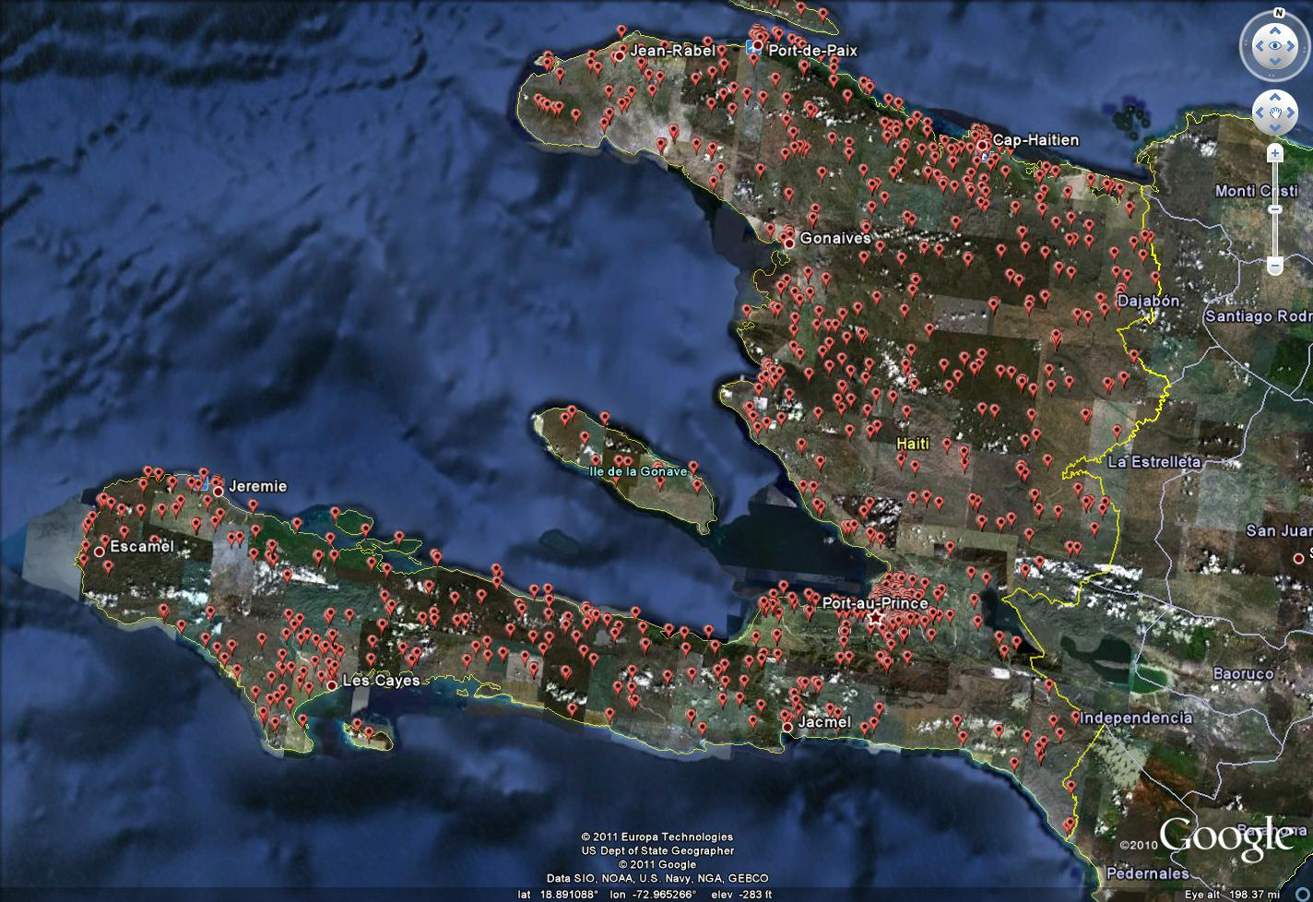
Notes:
For M&E, Google Earth is best suited for point data. For example here is a map in Google Earth showing the location of health facilities in Haiti.

Slide 43
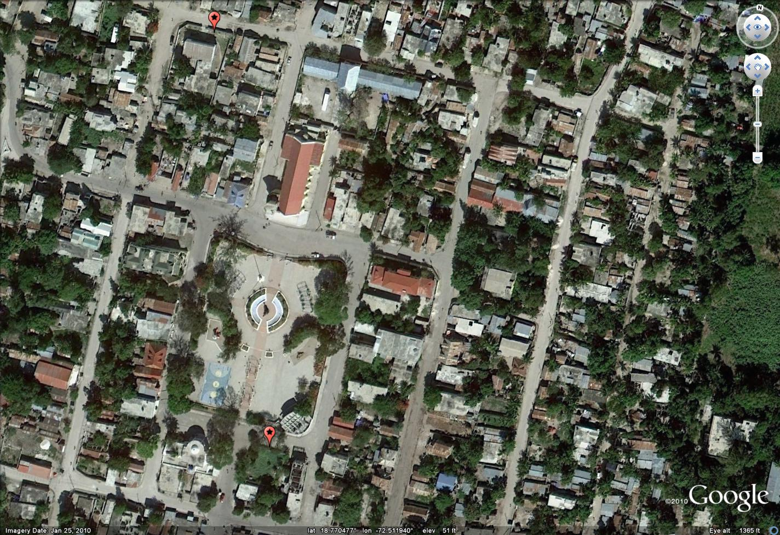
Notes:
If we zoom in you can see that it does a good job precisely identifying the location.

Slide 44
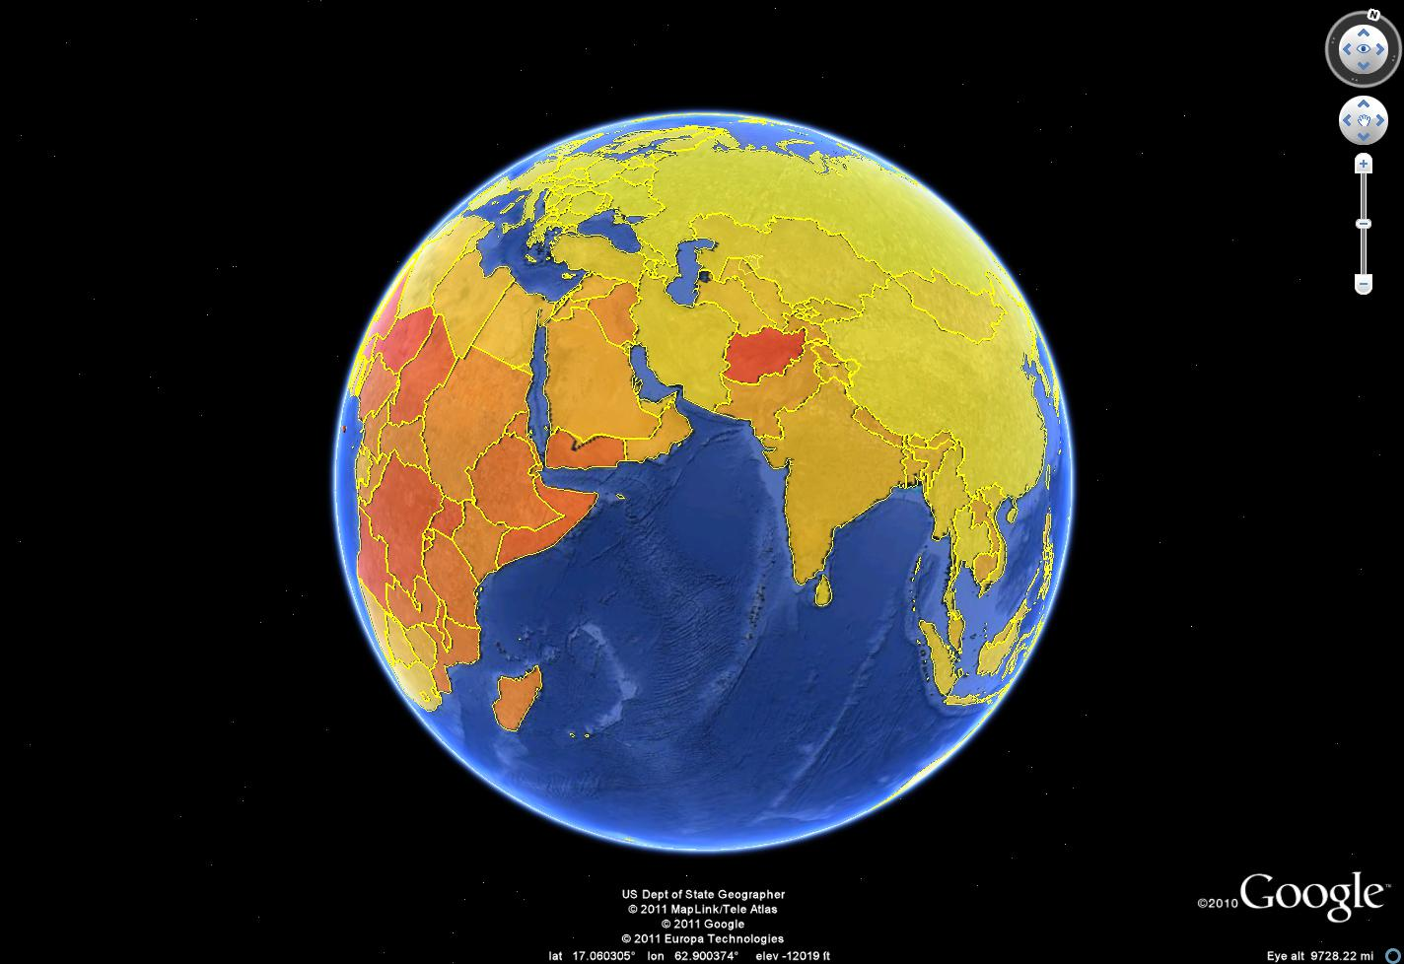
Notes:
It is much harder to do this type of mapping in Google Earth, polygon mapping. It requires special programming to draw the boundaries.

Slide 45
Google Earth (Free Version)
Pros
Free and easy
Feature-rich base maps
Great imagery and roads for many areas
Excellent display tool
Maps easy to export and share (subject to Terms of Use)
Notes:
What are the pros and cons of the Google Earth tool?
On the plus side, the biggest thing is that Google Earth is free. All you have to do is download the client software to your computer. Google Earth also has excellent base maps, which include high-resolution imagery and detailed roads data for many urban areas in Africa. And there is lower resolution imagery for the rest of the continent. The imagery, roads, and other features make Google Earth an excellent display tool for data that are not confidential in nature.
Last but not least, maps you create in Google Earth can be saved as images or KML files, and can be e-mailed or posted to a Web site in accordance with the Google Terms of Use.
45

Slide 46
Google Earth (Free Version)
Pros
Free and easy
Feature-rich base maps
Great imagery and roads for Africa
Excellent display tool
Maps easy to export and share (subject to Terms of Use)
Cons
System requirements
Administrative boundaries available only at national level
Polygons and thematic maps require custom programming
Data not secure
Lacks cartographic tools
Notes:
What are the cons?
First there are the system requirements.
46

Slide 47
Google Earth
PC System Requirements for Google Earth
Minimum:
Operating System: Windows 2000, Windows XP, or Windows Vista
CPU: Pentium 3, 500Mhz
System Memory (RAM): 256MB
Hard Disk: 400MB free space
Network Speed: 128 Kbits/sec
Graphics Card: 3D-capable with 16MB of VRAM
Screen: 1024x768, "16-bit High Color" - DirectX 9 (to run in Direct X mode)
Recommended:
Operating System: Windows XP or Windows Vista
CPU: Pentium 4 2.4GHz+ or AMD 2400xp+
System Memory (RAM): 512MB
Hard Disk: 2GB free space
Network Speed: 768 Kbits/sec
Graphics Card: 3D-capable with 32MB of VRAM
Screen: 1280x1024, "32-bit True Color"
Notes:
As you can see on this slide, even the minimum system requirements are pretty demanding: Pentium 3 processor, 400 MB disk space, ISDN network/Internet connection speed, 3D graphics card, and a fairly high resolution monitor. And the recommended system configuration calls for doubling some of these requirements, such as going from 256 MB system memory to 512 MB, and requiring a 3D graphics card with 32 MB of VRAM as opposed to only 16. The recommended disk space available for caching content is 2 GB. And the recommended network/Internet connection speed jumps up to 768 Kilobits/sec, which is six times the minimum speed identified.
47

Slide 48
Google Earth (Free Version)
Pros
Free and easy
Feature-rich base maps
Great imagery and roads for Africa
Excellent display tool
KML is standard
Plug-in for Web browser
Maps easy to export and share (subject to Terms of Use)
Cons
System requirements
Administrative boundaries available only at national level
Polygons and thematic maps require custom programming
Data not secure
Lacks cartographic tools
Notes:
System requirements are the big hurdle. Once you get past that, you’ll see that Google Earth offers national boundaries, but except for a few instances doesn’t provide administrative division boundaries below that level. This can present an obstacle to using Google Earth to map your M&E data in relation to regions, provinces, districts, etc.
A related issue is that Google Earth displays point locations very well, but does not do as well with polygons without custom programming or moving up to Google Earth Pro. What do I mean by that? Well, since Google Earth doesn’t provide boundaries below the national level, if you want to create thematic maps below that level you have to supply the boundaries yourself. If you have the boundaries you can convert them to KML using third-party tools, but then it’s difficult to associate your M&E data with the KML boundaries.
Another thing to note is that the data you display using the free version of Google Earth are not entirely secure, since the coordinates are transmitted to the Google servers so they know which data to send to your client software for display. If you wanted to map confidential data associated with individuals, for example, Google Earth would not be the right tool. If you summarized the data at a national level, however, or by administrative divisions that could be mapped using the E2G tool, then Google Earth would be an excellent choice for data visualization.
Also, Google Earth is not a true mapping program, and therefore lacks some of the standard cartographic tools one might like to have, such as adding a north arrow, customized scale bar, legend, etc.
48

Slide 49
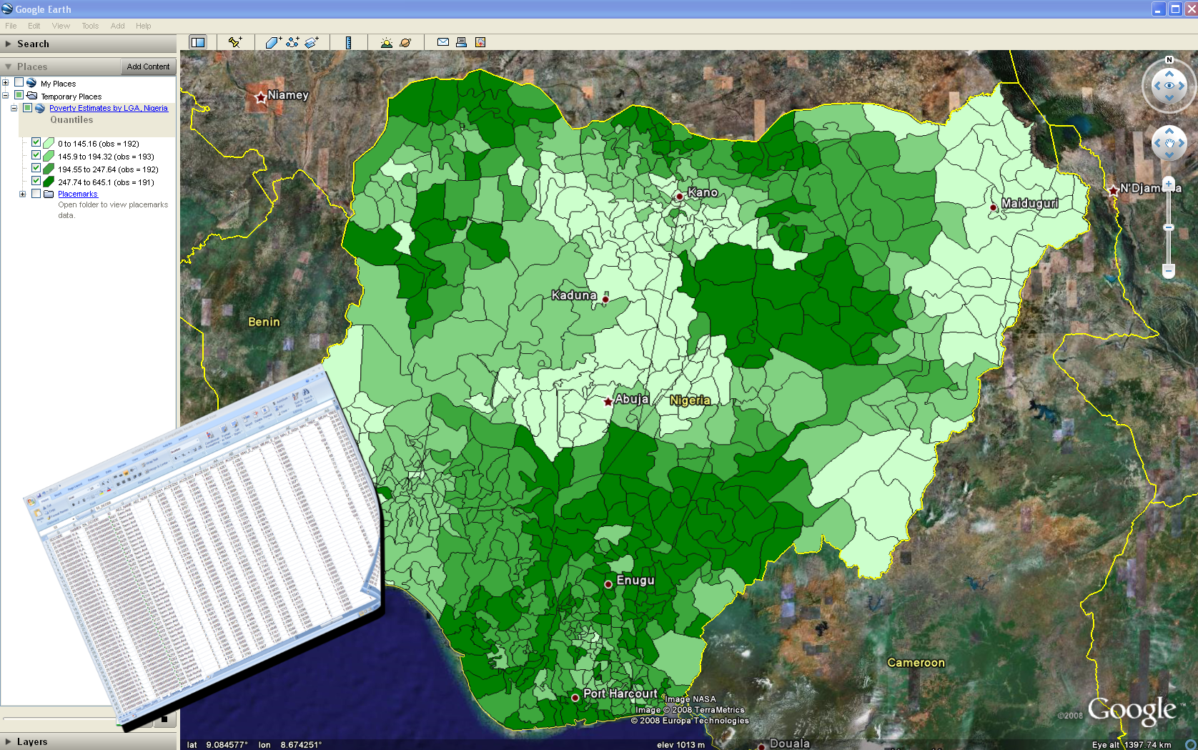
E2G
Notes:
The last tool we’ll present is the E2G tool produced by MEASURE Evaluation

Slide 50
E2G
Maps Excel Data in Google Earth
Free
Basic Cartographic Display
Notes:
I mentioned that in order to do polygon mapping in Google Earth, you need special programming to create the polygons. At MEASURE Evaluation we created a tool to try and make that process easier. It’s called E2G for Excel to Google Earth. It lets users take data they have in Excel and display it in Google Earth.

Slide 51
E2G
Excel data
  Must be in standard data schema
    One record per geographic unit
  Must use standard administrative names
    List is provided
Notes:
In order to use E2G, the Excel data must be well formed. That means it conforms to the standard data schema format we discussed in Lesson 2. In other words, there must be one record per geographic unit.
Additionally the spreadsheet must use standard administrative names. To make this easier, the tool provides a list of administrative names for each of the countries available for mapping in the tool.

Slide 52
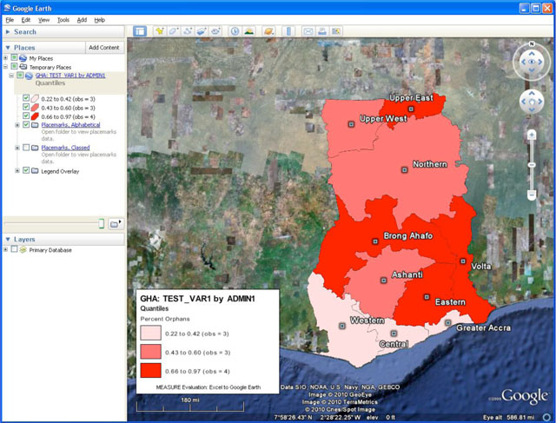
E2G
Notes:
If your data is well formed, E2G will create a map like this in Google Earth.

Slide 53
E2G
Pros
Free
Easy to use
Extensive training and support materials
Well suited for quick geographic display of data
Notes:
The pros for E2G are: it is free and it is easy to use. MEASURE Evaluation has created training and support materials to help users. The last pro is that it is well suited for quick geographic display of data

Slide 54
E2G
Pros
Cons
Free
Easy to use
Extensive training and support materials
Well suited for quick geographic display of data
Not available for every country (~40 countries)
Requires ability to connect to Internet at least once
Google Earth system requirements
No GIS ability
Notes:
The cons are that it doesn’t produce maps for every country, though it does support mapping for nearly 40 countries. In order to use it, Google Earth must be able to connect to the internet at least once. Additionally, as we discussed Google Earth does have system requirements that could be a barrier to use of E2G. Lastly, it is important to stress that E2G is not a GIS, so it doesn’t have GIS functionality. All it does is produce basic maps of data.

Slide 55
Resources Handout
Software training
Data resources
Other training
Notes:
Lastly, we’ll conclude with a discussion of available resources. The use of geographic tools and data is a topic worthy of a whole workshop in and of itself, so we were only able to touch on the basics. These resources will hopefully make it possible to gain more information.

Slide 56
MEASURE Evaluation is funded by the U.S. Agency for
International Development and is implemented by the
Carolina Population Center at the University of North
Carolina at Chapel Hill in partnership with Futures Group
International, ICF Macro, John Snow, Inc., Management
Sciences for Health, and Tulane University. The views
expressed in this presentation do not necessarily reflect
the views of USAID or the United States Government.

